Slide 1
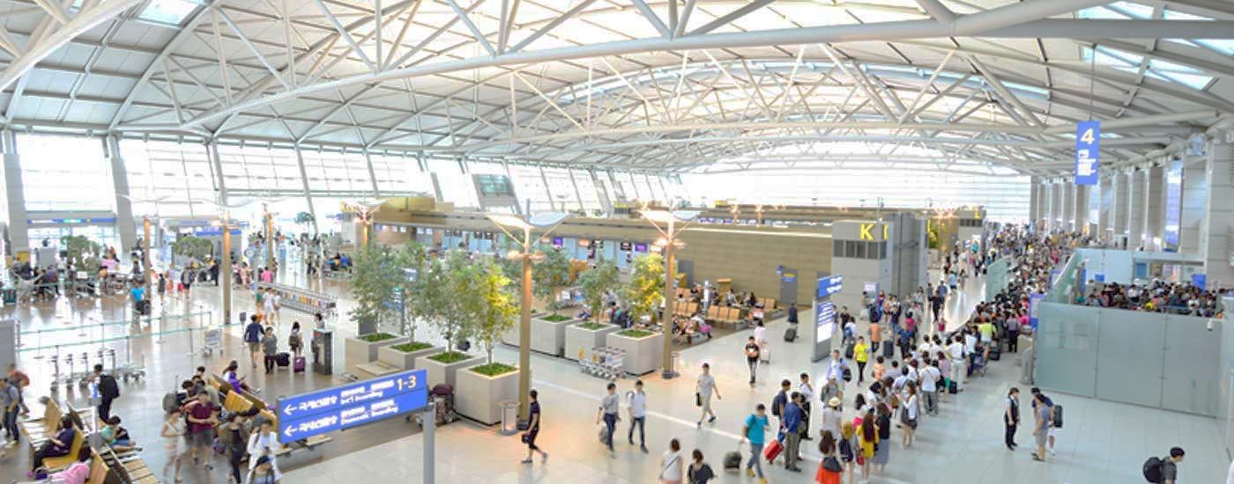
FootfallCam 3D PlusTM
For airports
©2019 Footfall Counter is trademark application of FootfallCam in various jurisdictions. We reserve the right to introduce modifications without notice. All other company names and products are trademarks of their respective companies.

Slide 2
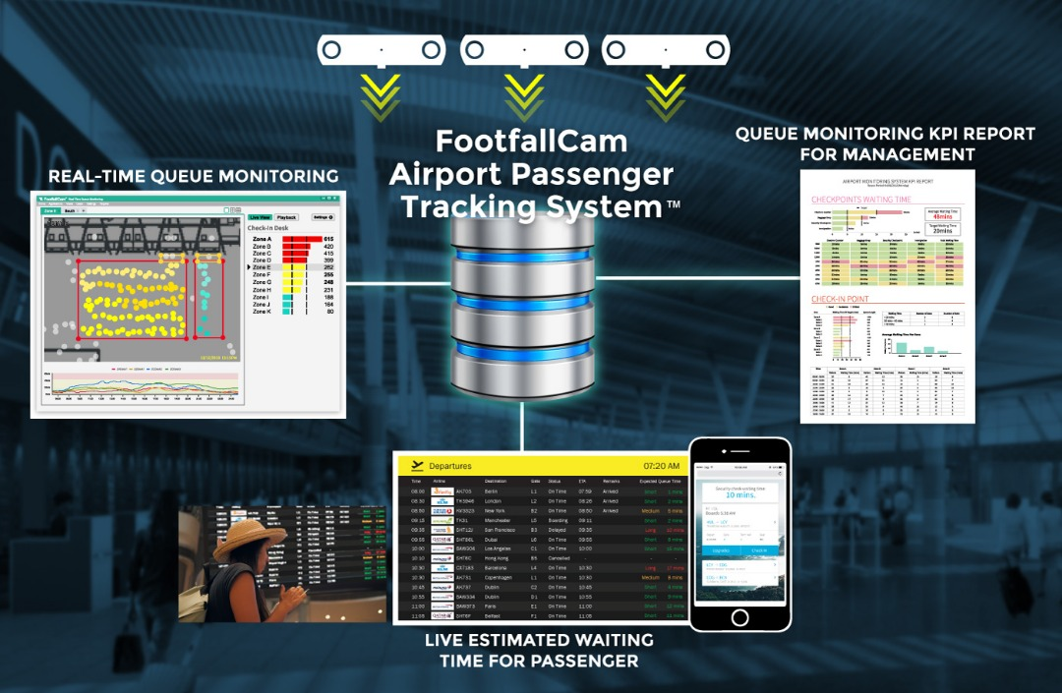
Airport passenger tracking system

Slide 3
Key
solutions

Slide 4
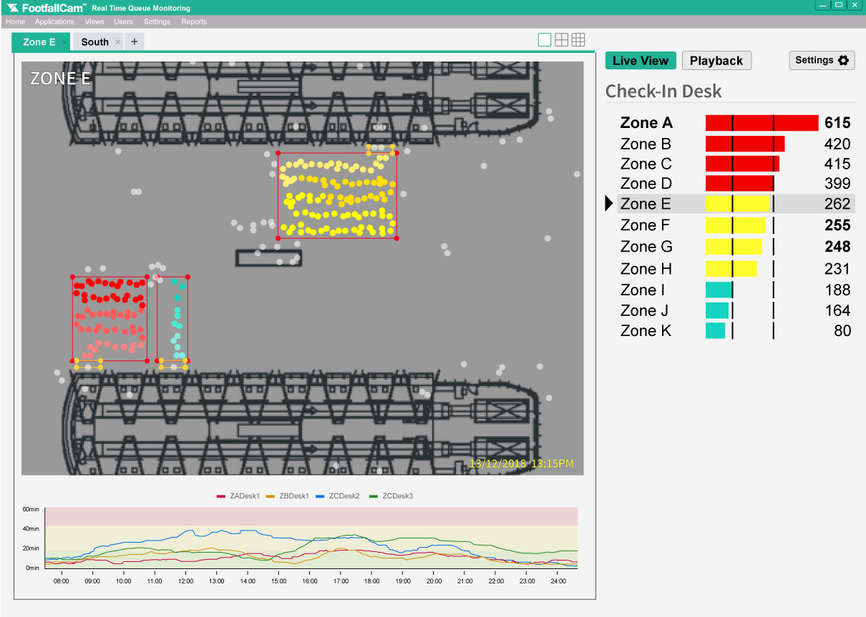
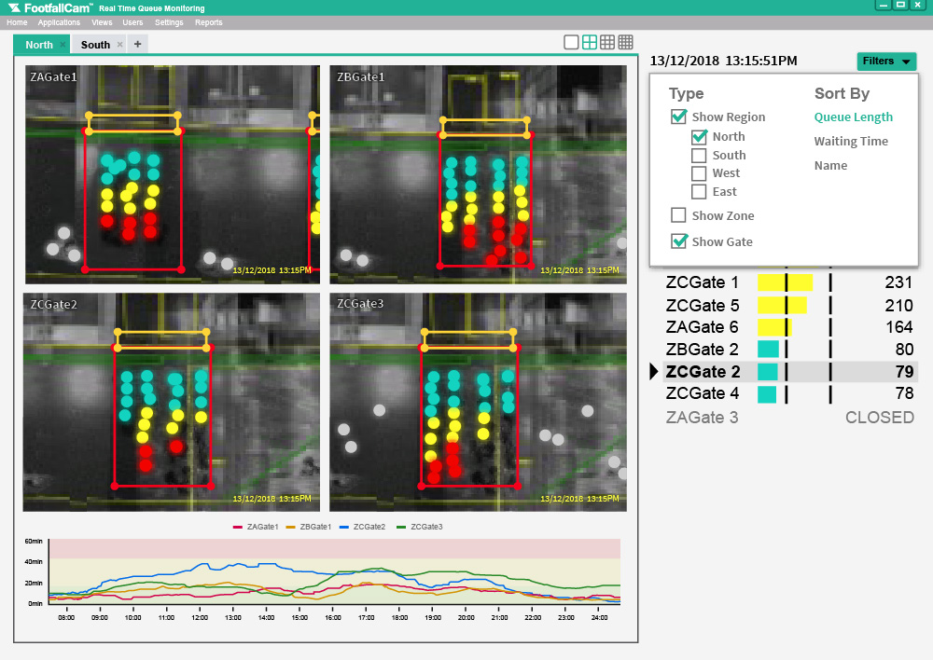
#1 Passenger flow information interface
Real time queue monitoring
Airport operator would be able to monitor in real time of the queue length of all areas, and could assign resources to address area with excessive waiting time.

Slide 5
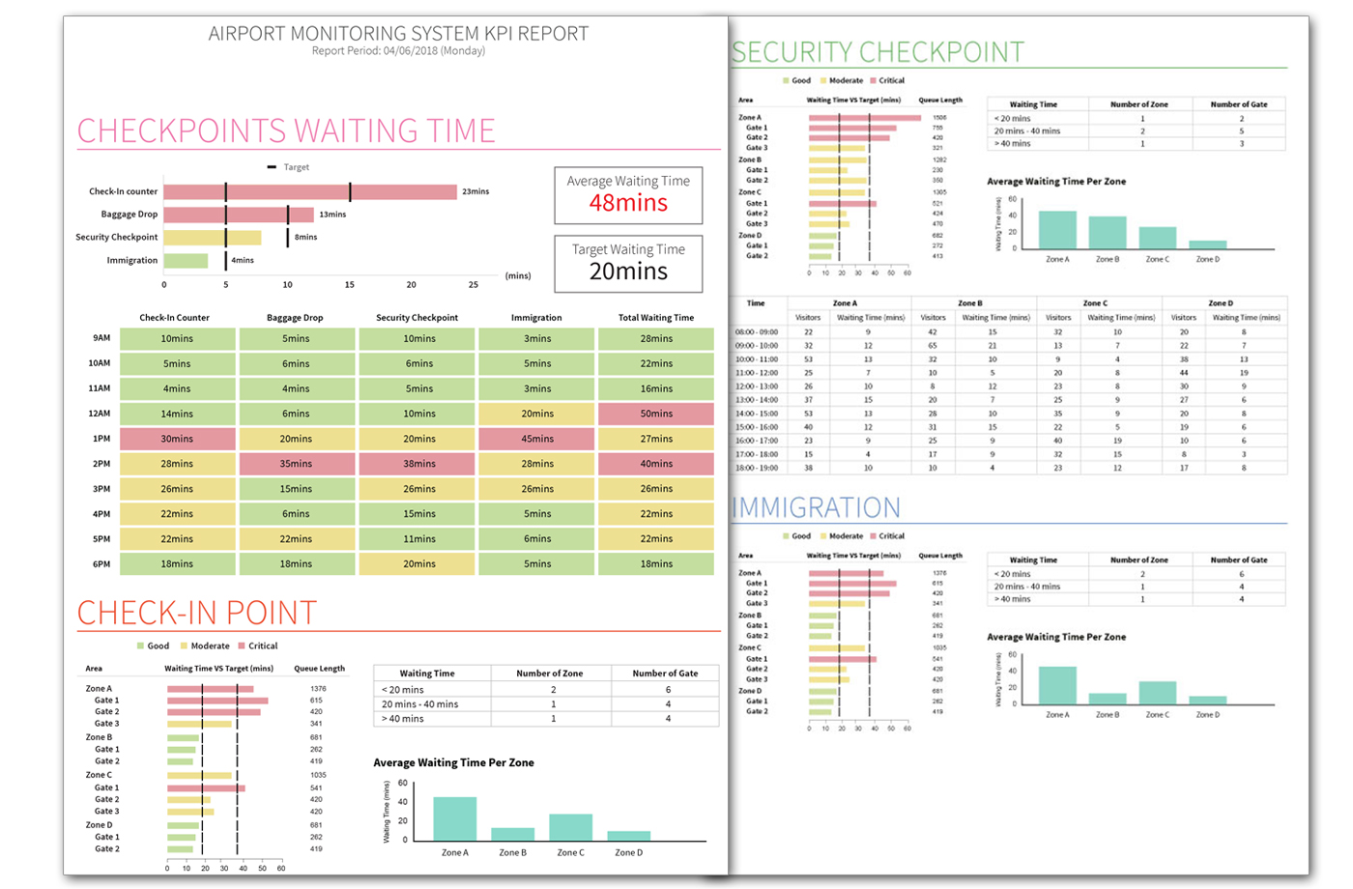
Download the complete sample report here.
#2 KPI performance review
Airport passenger flow KPI
Airport top management can quantify the passenger satisfaction based on their waiting time in check-in lobby, security checkpoint, immigration desk and baggage collection. It allowed the management to Identify the weakest link and define a clear goal for the operation team.

Slide 6
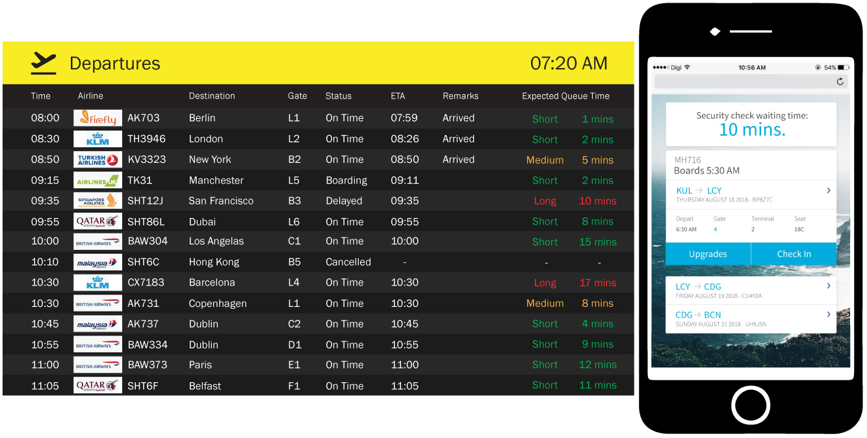
#3 Real time monitoring
Waiting time information dashboard
The queue length and waiting time information can be exported to the Flight information dashboard or mobile app. It helps passenger to plan their journey and increase overall satisfaction.

Slide 7
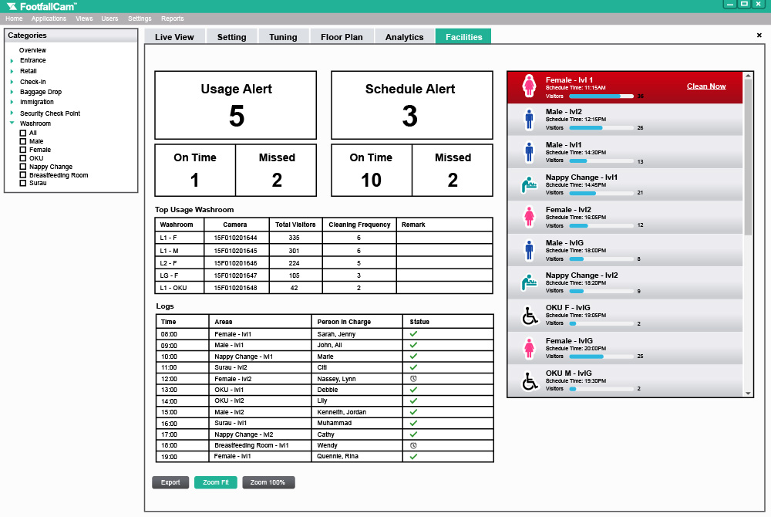
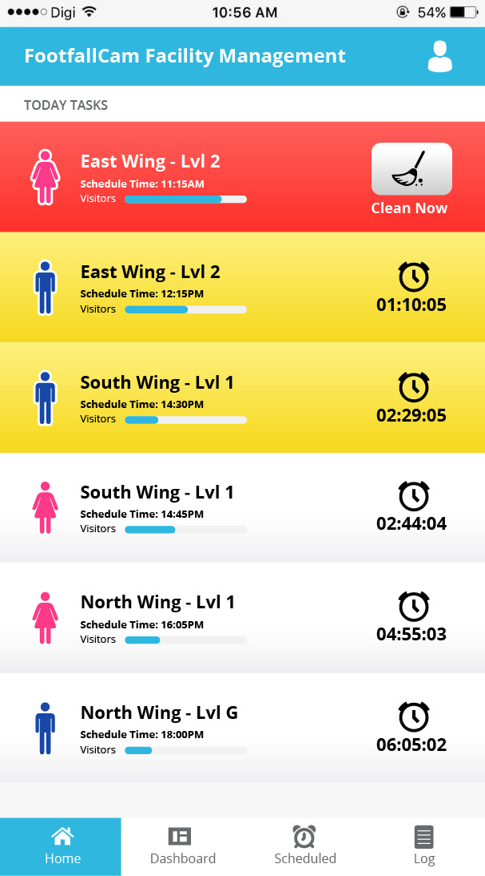
Facility management
Provide consistent service quality
By measuring the usage of facilities in the airport, management can create staff schedules that accurately reflect the condition of the facilities with busier areas receiving more attention. By reducing the workload staff spends on areas they are not needed, management can make cost savings decision and create better experience for passengers and visitors.
Reduce cost of staff operations
People counters can be placed at entrances to lounge rooms, restrooms, and conference rooms to provide a clear view of how resources are being used. Management will be able to identify what spaces are being underutilised or areas that are over-flowing with people. With this knowledge, management can schedule the allocation of staff to maintain the room in the most efficient way possible.

Slide 8
Other solutions
3
Key Features of FootfallCam 3D Counter

Slide 9
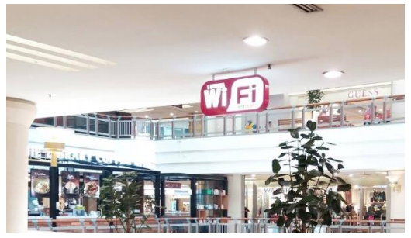
Wi-fi hotspot
Double up as a free wifi hotspot area with no additional hardware required
2

Slide 10
Our
services
3
Key Features of FootfallCam 3D Counter

Slide 11
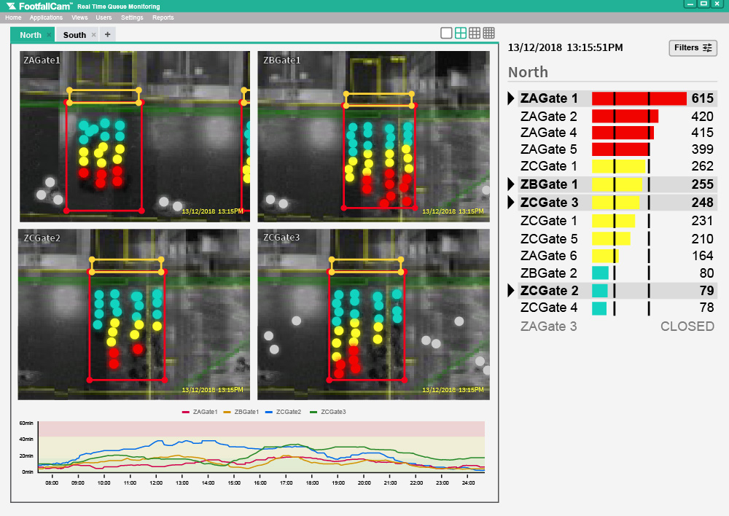
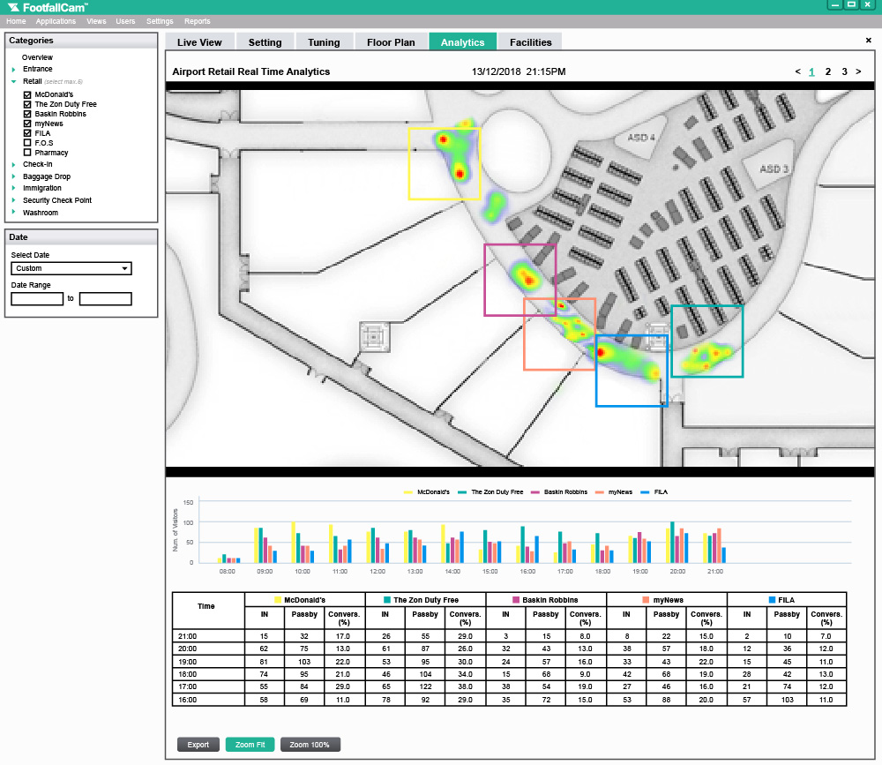
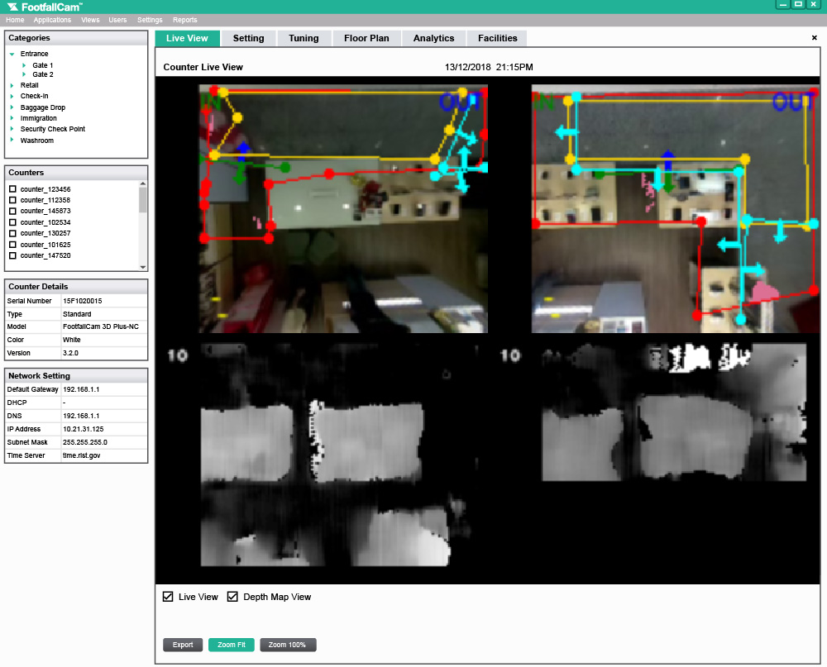
Guaranteed data privacy
Due to FootfallCam unique stereoscopic vision sensor with height filtering option, embedded with a person tracking algorithm, data privacy is always guaranteed. No video streaming occurs outside of the sensor. The only data sent out by the sensor is a stream of moving dots. The only data sent out by the sensor is a constant stream of moving dots, each dot representing a passenger.

Slide 12
Contact Us
You need further information or have a question?
Please visit:
www.footfallcam.com
Headquarters
46 Abbotswood, Guildford,
GU1 1UY,
United Kingdom
Asia Office
51-2, Jalan SL ¼,
Bandar Sungai Long,
43000 Kajang, Selangor Darul Ehsan, Malaysia
©2016 Footfall counter is trademark application of FootfallCam in various jurisdictions. We reserve the right to introduce modifications without notice. All other company names and products are trademarks of their respective companies.

